Slide 1

Street Level Intelligence for Autonomy
컴퓨터공학부 남예현

Slide 2

CARMERA
Autonomous Map
Site Intelligence
Fleet Monitoring

Slide 3

Ro Gupta
Current
CARMERA, Co-founder and CEO
Past
Autonomous Tractor Corp., Advisor
Disqus, Vice President
Disney, Head of BD & S
Education
Northwestern Univ., Kellogg School of Management, MBA
Princeton Univ., Civil Eng., BSE

Slide 4
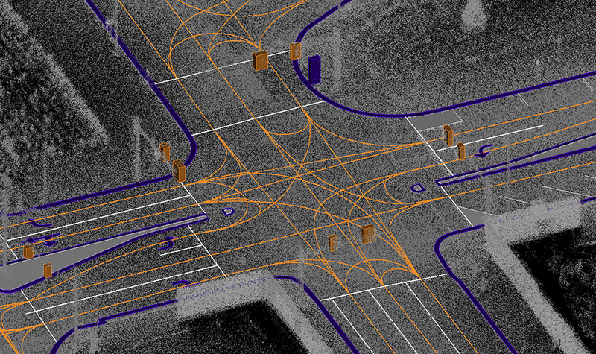
Autonomous Map
Fig 1. Autonomous Map Vector Data, retrieved from www.carmera.com/img/home/autonomous-map-vector.jpg
High Definition Map
HD Maps are maps particularly built for self-driving purposes

Slide 5
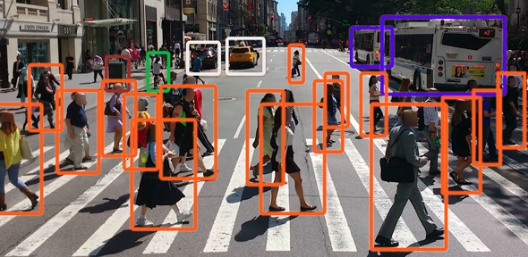
Site Intelligence
Fig 2. Tagging, retrieved from www.carmera.com/img/home/tagging.jpg
Spatial data and street analytics
Block-level pedestrian analytics
historical trend data
continually updated street imagery

Slide 6
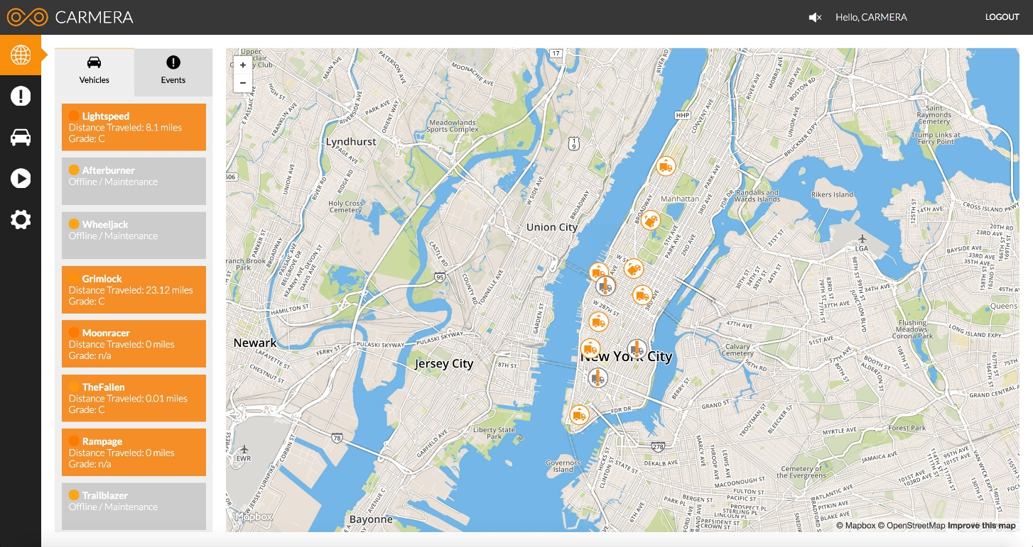
Fleet Monitoring
Fig 3. Fleet Monitoring, retrieved from www.carmera.com/img/home/fleet-v2.jpg
Fleet
Fleet vehicles are groups of motor vehicles owned or leased by a business, government agency or other organization rather than by an individual or family

Slide 7

Demo Video
Fig 3. CARMERA Animation, retrieved from www.carmera.com/video/Carmera_Animation_20180821r2.mp4

Slide 8
Funding

Slide 9
Prospect
Downtown Brooklyn Partnership
NYC DOT Partnership
Toyota Research Institute – Advanced Department

Slide 10
References
[1] Carmera. c2018. CARMERA. [Online]. [21 May 2019]. Available from: https://www.carmera.com/
[2] Angellist. 2010. Carmera at AngelList. [Online]. [21 May 2019]. Available from: https://angel.co/company/carmera/
[3] Fortune. c2018. Meet Carmera, A Startup Using Delivery Fleets to Create 3D Maps of Cities. [Online]. [21 May 2019]. Available from: https://fortune.com/2017/06/05/carmera-maps-funding/
[4] Techrunch. 2013. Carmera, the mapping startup for autonomous vehicles, raises $20 million. [Online]. [21 May 2019]. Available from: https://techcrunch.com/2018/08/23/carmera-the-mapping-startup-for-autonomous-vehicles-raises-20-million/
[5] Toyota. c2019. TRI-AD and CARMERA team up to build high definition maps for automated vehicles using camera data. [Online]. [21 May 2019]. Available from: https://global.toyota/en/newsroom/corporate/26879165.html

